Slide 1
Polynomial Functions

Slide 2







Polynomial Function – a function in the form:
where
$x$ is a variable
the coefficients of the variable are real numbers
the exponents are non-negative integers
Identify the polynomial functions. Explain why the other functions are not polynomial functions.
$$f\left(x\right)=x^{2}+3x+2$$
$y=4x^{3}$+${8x}^{2}+3x−2$
$f\left(x\right)=\sqrt{x^{5}}$ $+3x^{2}+6$
$$y=2x$$
$$f\left(x\right)=\frac{3}{4}x^{3}+9x^{−2}+10x$$
$$y=\frac{3x^{2}+6x+10}{2x}$$

Slide 3
Vocabulary
The degree of the polynomial function is $n$, the exponent of the greatest power of $x$.
Relates to the number of solutions (real, imaginary, equal, etc)
Relates to the end behavior
degree of 4
The leading coefficient of the polynomial function is${ a}_{n}$, the coefficient of the greatest power of $x$.
Relates to the direction of end behavior
+1
The constant of the polynomial function is $a_{0}$, since$x^{0}$=1.
Relates to the y-intercept of the graph of the function
-6

Slide 4
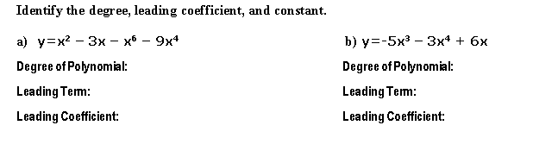
6
4
-1
-3
1

Slide 5
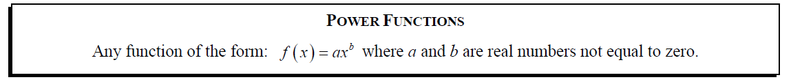
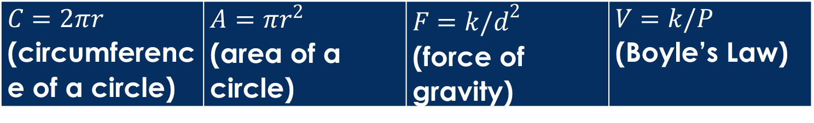
Power Functions
Notice: It is a monomial!!! ONE Term.
Some common examples:
$C=2πr$ (circumference of a circle) | $A=πr^{2}$ (area of a circle) | $F=k/d^{2}$ (force of gravity) | $V=k/P$ (Boyle’s Law)

Slide 6
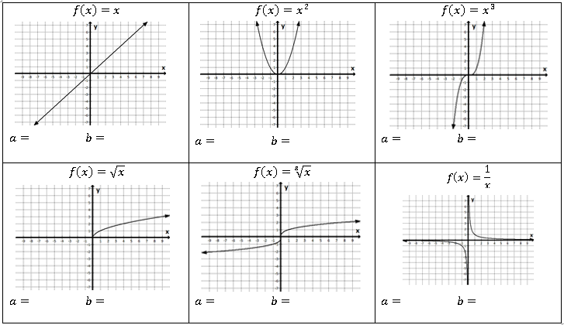
1
1
1
2
1
3
1
1
1
-1

Slide 7
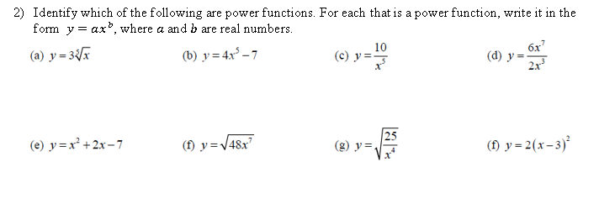


Slide 8
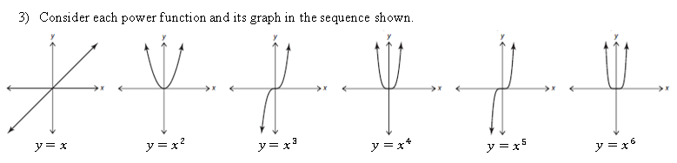
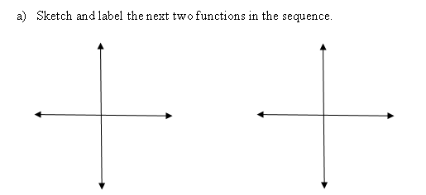

Slide 9
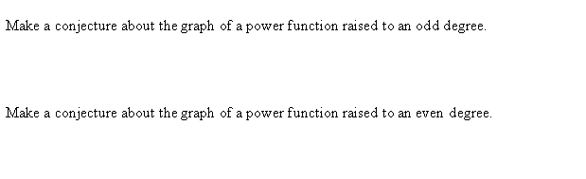
B)
C)

Slide 10
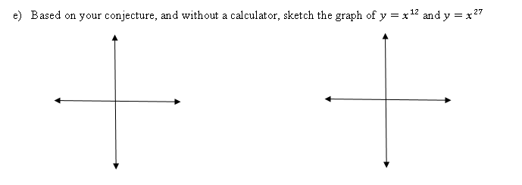

Slide 11
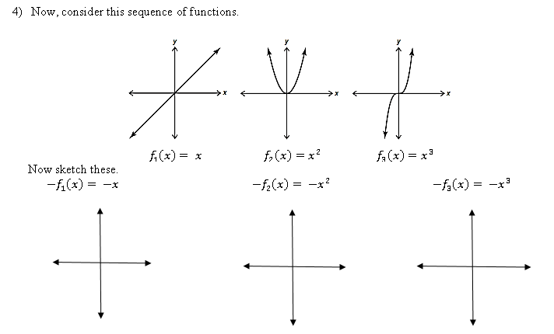

Slide 12
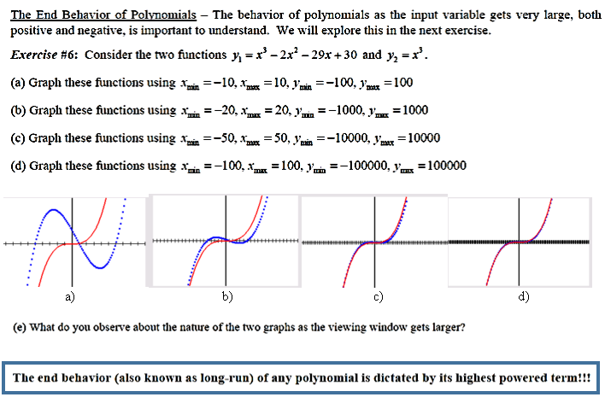

Slide 13
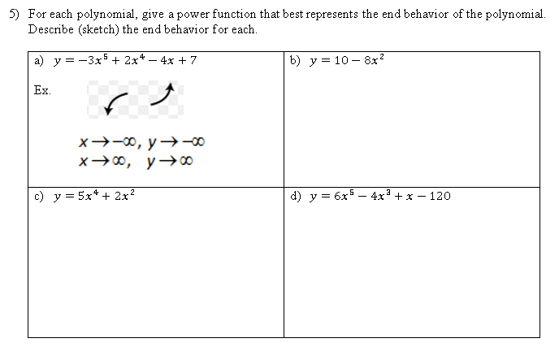
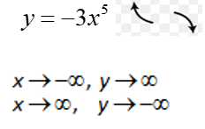







Slide 14

Which graph could represent a polynomial whose leading term is $−3x^{4}+…$?
B
b) Which graph could represent a polynomial whose leading term is $3x^{4}+…$?
D
c) Which graph could represent a polynomial whose leading term is $4x^{3}+…$?
A
d) Which graph could represent a polynomial whose leading term is $−4x^{3}+…$?
C

